Slide 1
TCP/IP Protocol Suite

Slide 2
Introduction
TCP/IP stands for Transmission Control Protocol / Internet Protocol.
Defined in earlier 1974
Do not exactly match with OSI reference model.
Consist of 4 layers:
Network Access Layer
Internet Layer
Transport Layer
Application Layer

Slide 3
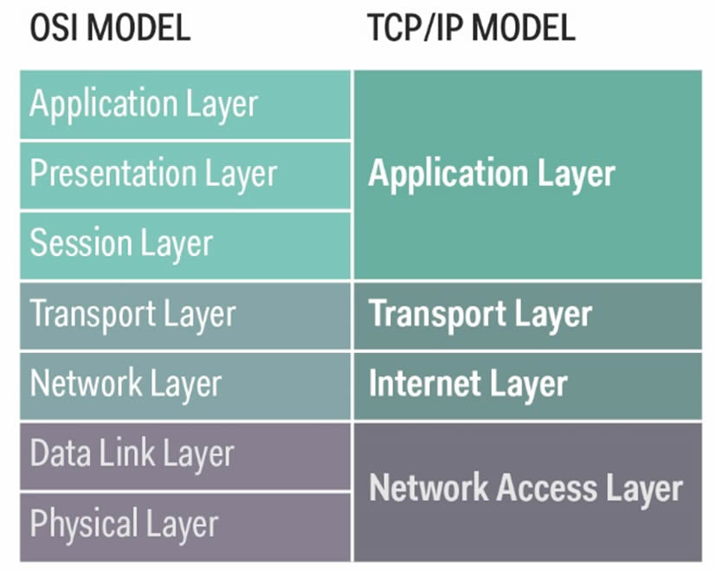
TCP/IP model:

Slide 4
Network Access Layer
Does not define specific protocol
Supports all standard protocols
Can be LAN or WAN

Slide 5
Internet Layer
Supports Internetworking Protocol(IP)
No error checking and tracking
Deliver message with no guarantee
Routes the data packets independently
Uses four supporting protocols: ARP, RARP, ICMP and IGMP

Slide 6
Transport Layer
It is a host to host protocol
Consist of 2 protocol: UDP and TCP
Connection establishment
Establishes the fix path

Slide 7
Application Layer
Functions same as application layer in OSI model
Responsible for providing services
Contains all higher level protocols Like:
1. TELNET
2. FTP(File Transfer Protocol)
3. SMTP(Simple Mail Transfer Protocol)
4. DNS(Domain Name System) etc.

Slide 8
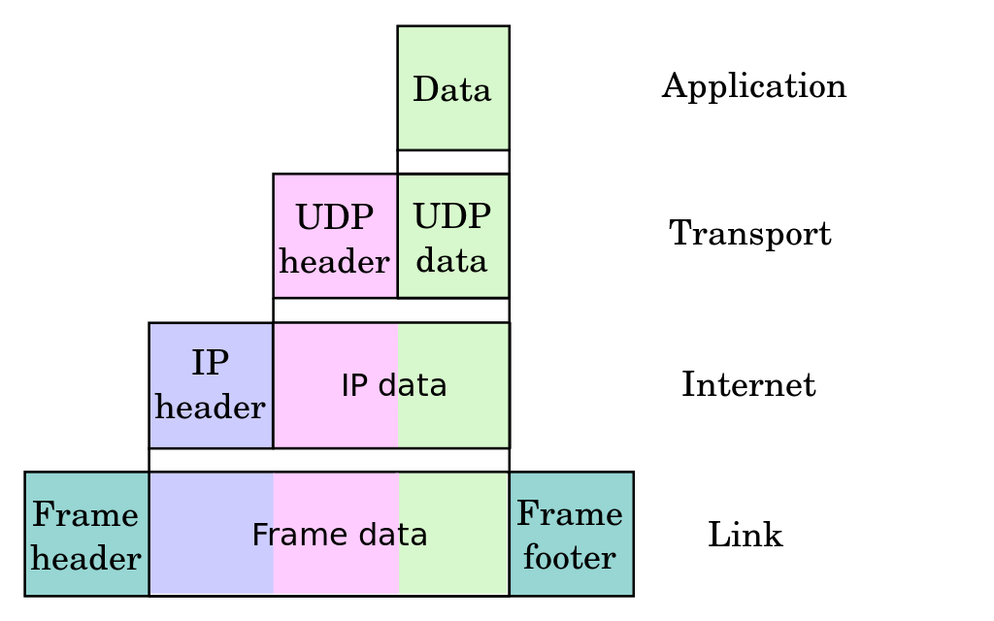
Data Encapsulation in TCP/IP
Application Layer: Data
Transport Layer: Header, Data
Internet Layer: Header, Header, Data
Network Access Layer: Header, Header, Header, Data

Slide 9
Protocols used in TCP/IP
Application Layer:
FTP, SMTP, Remote Login(Rlogin), SNMP, DNS etc.
Transport Layer:
UDP, TCP, SCTP(new protocol defined)
Internet Layer:
IP, ICP, ARP, RARP
Network Access Layer:
Ethernet, Proxy, FDDI, ATM, Fast Ethernet etc.

Slide 10
DNS AND URL

Slide 11
IP ADDRESS
Internet protocol
IP addresses are how computers identify other computers on the internet

Slide 12
URL
Uniform Resource Locator (URL) is the address of a resource on the Internet.

Slide 13
FORMAT
scheme://location:port/file-on-server.htm?querystring=1
Scheme:
HTTP AND HTTPS
FTP(File Transfer Protocol)
MAIL TO
IRC(Chat room)

Slide 14
HTTP
Most common used schemes (protocols)
Supports
FTP and MAIL TO

Slide 15
DOMAIN NAME
Domain Name System (DNS) gives us humans an easy way to identify where we want to go on the internet.

Slide 16
Each domain name is made up of parts:
third-level-domain.second-level-domain.top-level-domain
TOP- level domain server
.com
.net
.edu
.org

Slide 17
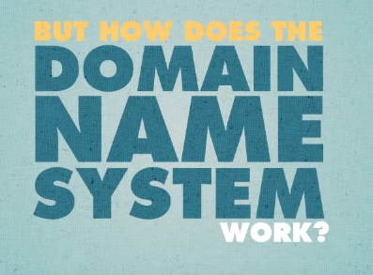

Slide 18

Operating system

Slide 19
4 DNS servers involved in loading a webpage
1.Resolving name server(DNS recursor)
2.The ROOT server
3.TLD name server
4.Authoratative name server

Slide 20
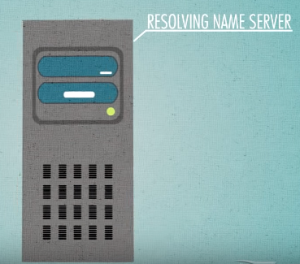

cache

Slide 21
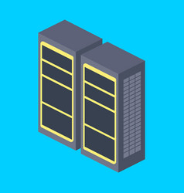
THE ROOT
First step of translating host name to ip
It serves as a reference to other more specific location.
13 Root servers

Slide 22
TLD name server
Send to Authoratative server.

Slide 23
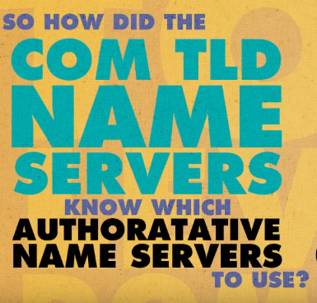

Slide 24
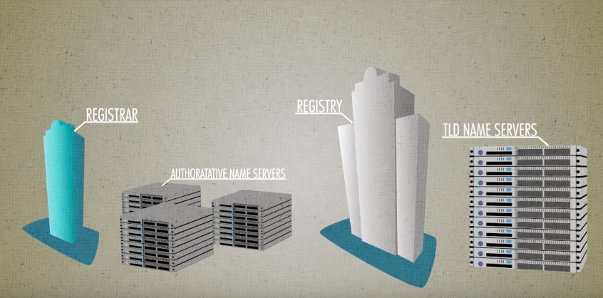

Slide 25

Authoratative server
Then authoratative send the ip .

Slide 26
Symbol
/ ➔path(location)
? ➔query
& ➔multiple query
# ➔inside of that webpage.

Slide 27
Thank you!!!.

